Slide 1
Webinar: Prefabrication

Slide 2
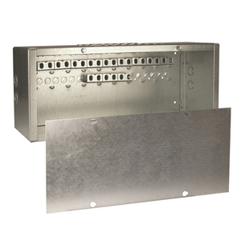
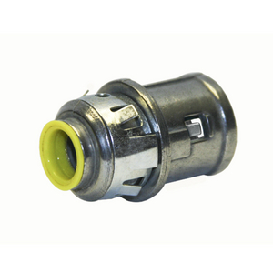
Previous Webinars!
Product Launches
Plenum Line
38RAC / 40RAC
Dugout
939 Old Work Ceiling Brace Kit
Webinar Series
8/28 Pricing
Block-Loc Boxes in Masonry Applications
Plenum Box
Certification Training Presented by Dan Gibson
Ceiling Fan Boxes
Product Promotion
248HS
Follow us on Social Media
Hubbell Commercial Construction

Slide 3
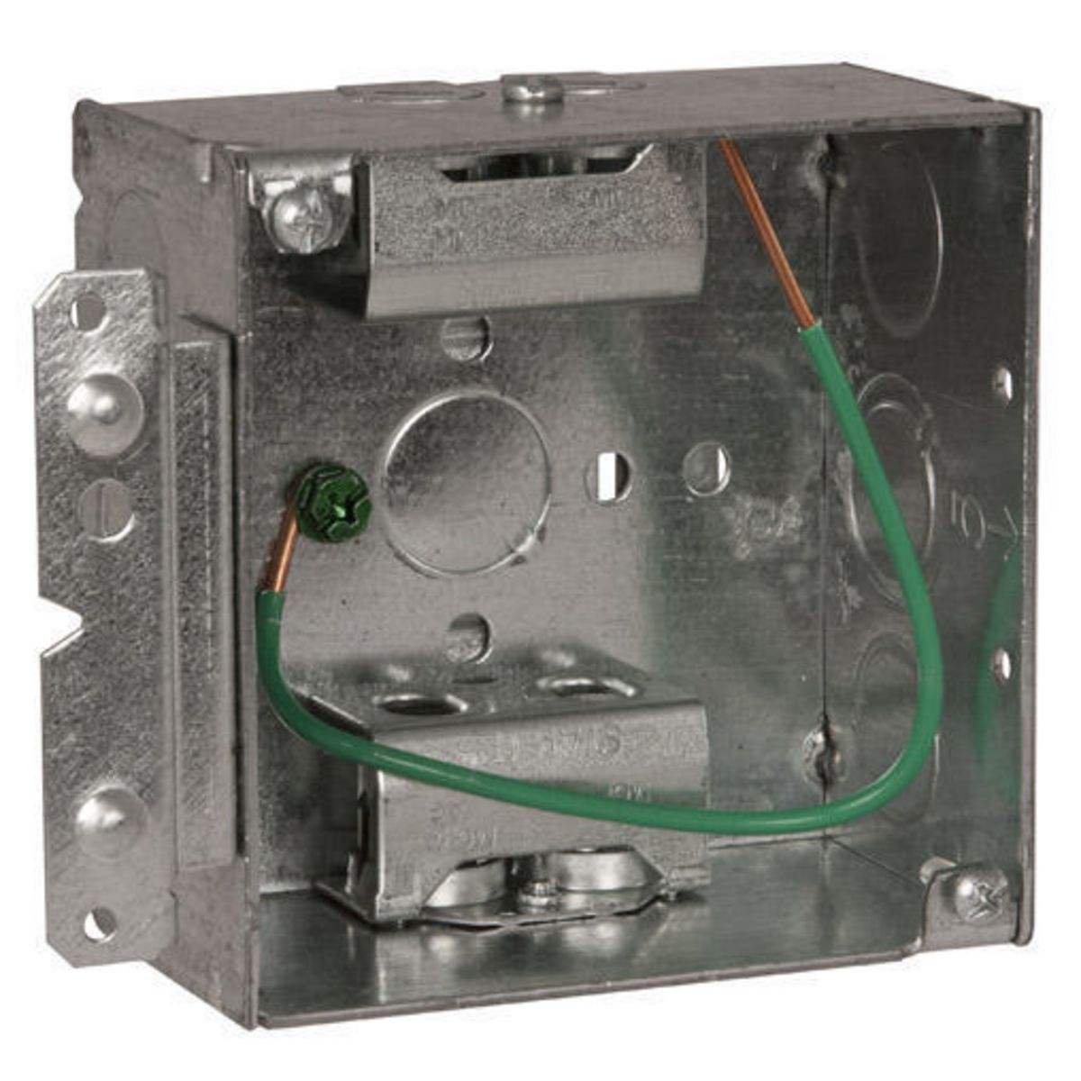
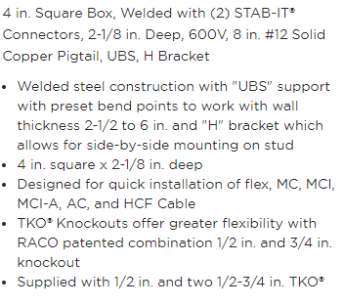
Special Promotion: 248HS

Slide 4
Special Promotion: 248HS

Slide 5
Prefabrication
Market Conditions
Current Offerings
Future Initiatives & Drivers

Slide 6
Prefabricated Assemblies

Slide 7
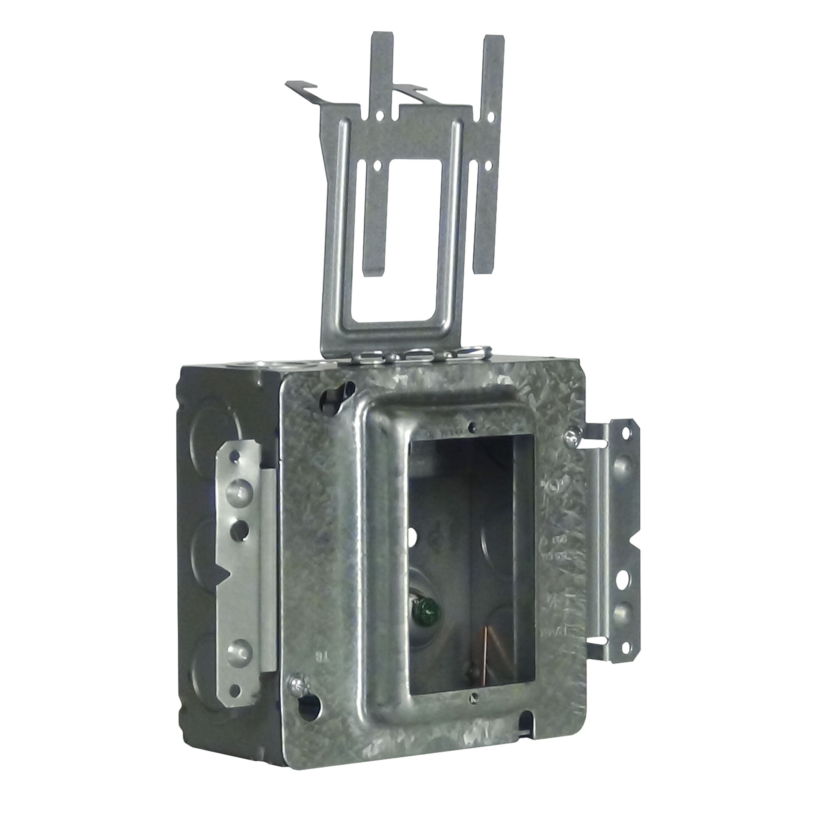
Drivers
Primary Drivers
Voice of Customer
Industry Developments
Code Changes
New Electrical Codes
Completion of the Product Family

Slide 8
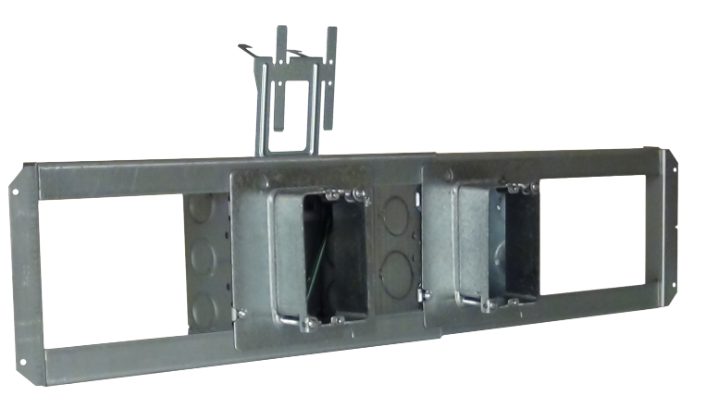
Drivers
Voice of Customer
What is the biggest challenge facing you in your position?
What is the biggest challenge facing the growth of your company?
Labor
Project / Jobsite Organization
Covid Challenges?
Webinar Series Engagement
Dungethum@Hubbell.com
574-339-7244

Slide 9
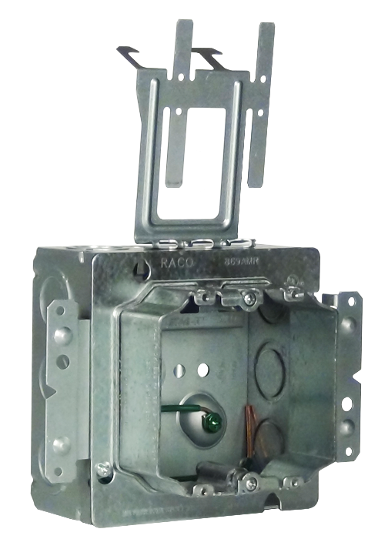
Drivers
Industry Trends
Move to Modularization / Prefab.
Contractors developing R&D Centers
Personnel / Team Management
Wearable Sensors for Personnel Tracking
Key Statistics of the Construction Industry
50% of all construction in the U.S. is expected to occur in just 20 cities over the next 5 years.
56% of Contractors Registered Projects with US Green Building Council or Leadership in Energy and Environmental Design Over the Past 3 Years
35.9% of Construction Employees are Change Resistant to Technology
55% of Firms Utilize Building Information Modeling
82% of Contractors Agree BIM is the Future
70% of Contractors Say BIM is not Standardized Adequately
78.7% of Construction Companies Utilize Apple as Their Mobile Software
59% of Construction Companies Utilize Bluebeam for plan Management

Slide 10
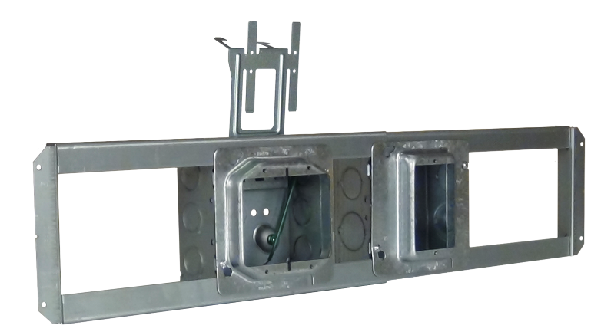
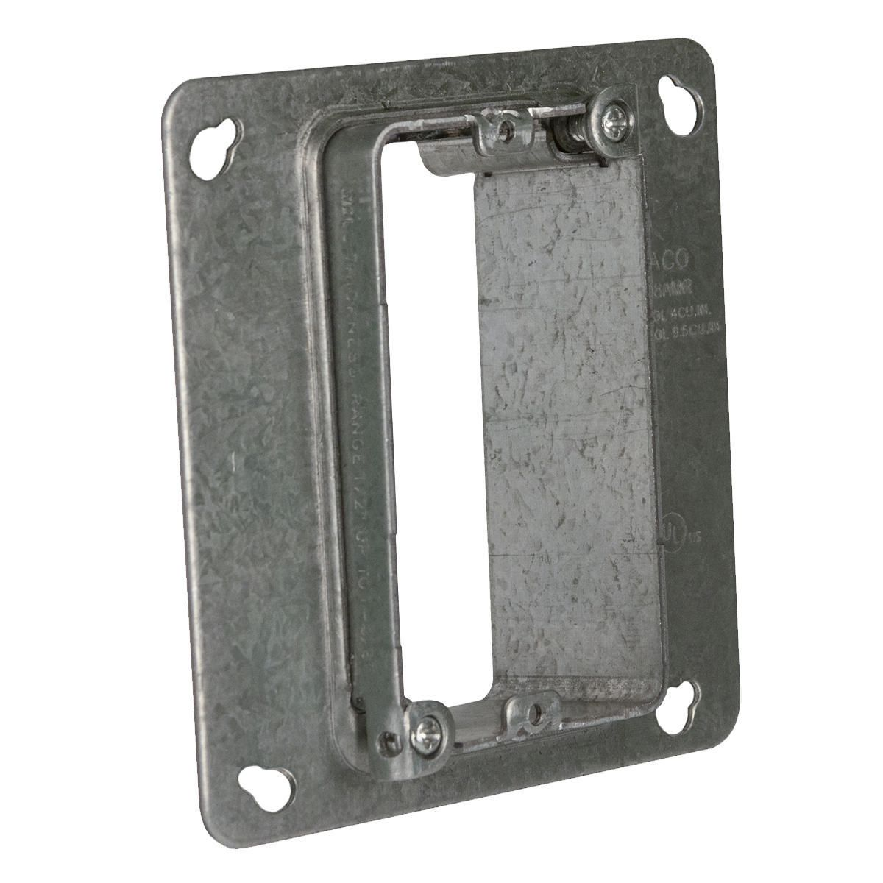
Drivers
Solutions
Stab-iT
Grand Slam
Dugout
Open Center Brackets
Mud Rings
Data Boxes
Pre-Fab line

Slide 11
Prefabrication Solutions

Slide 12
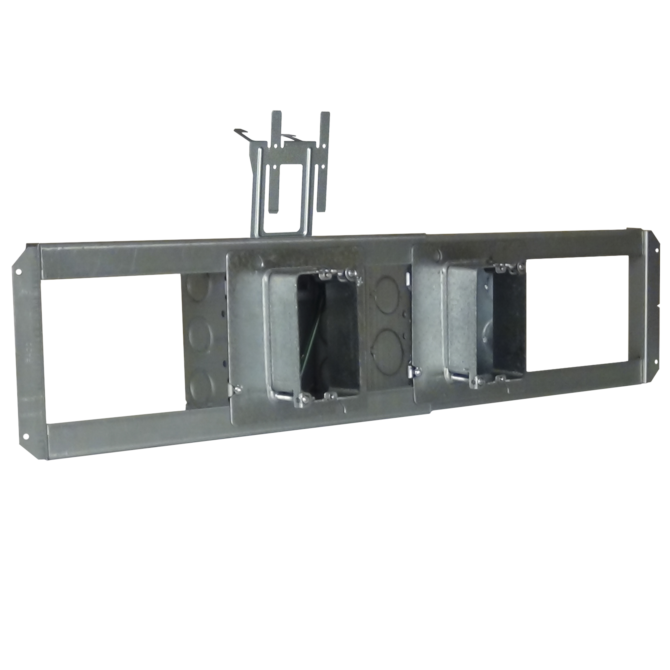
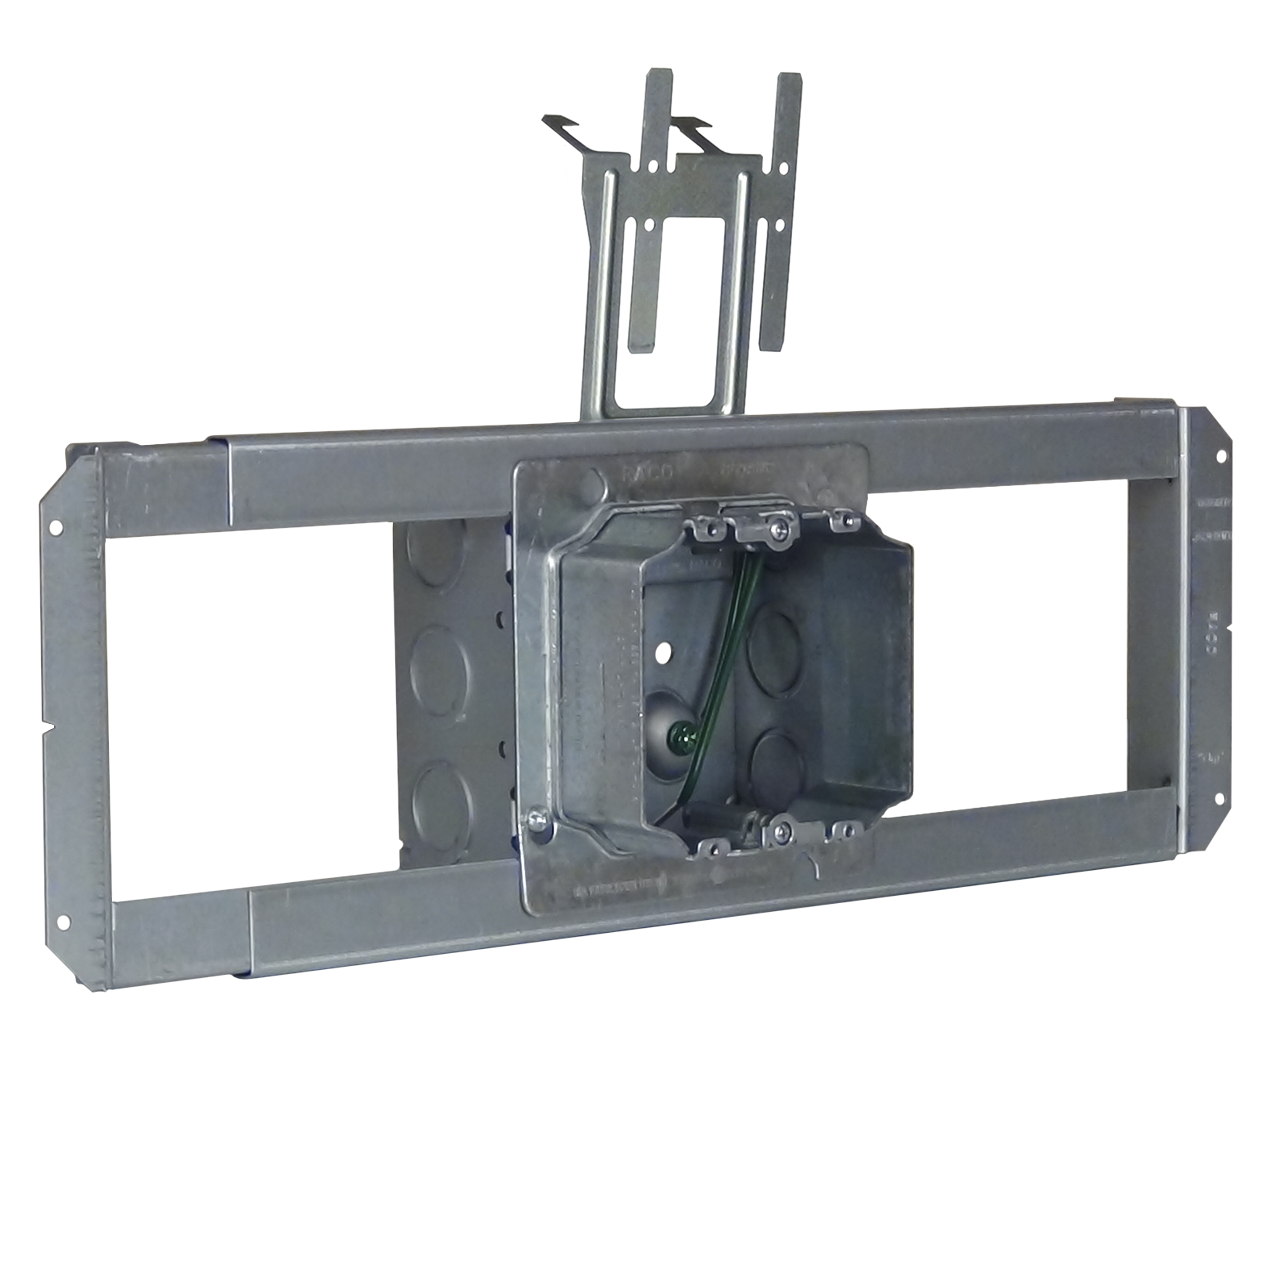
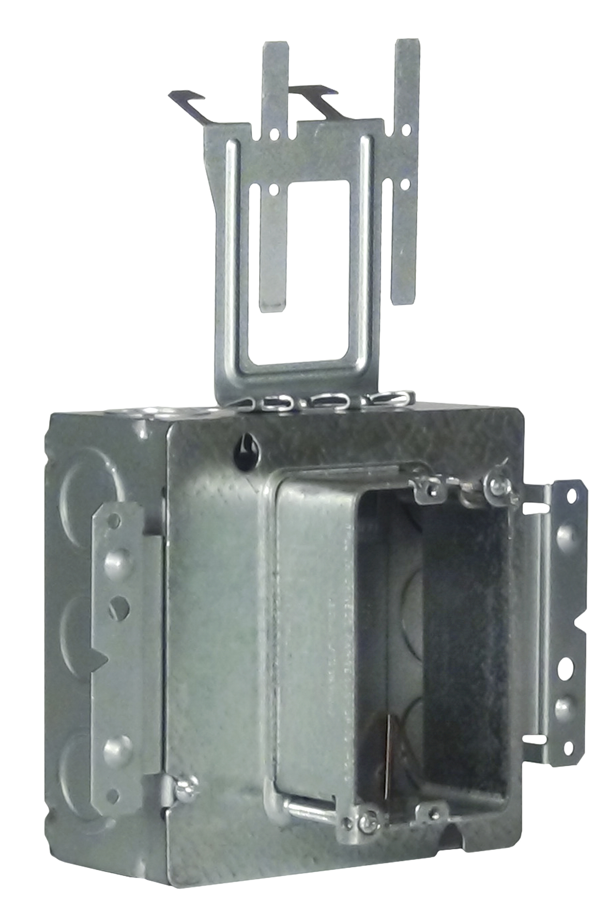
Prefabrication
Prefab Solutions
20 Current SKUs
4 11/16 Stab-iT II
4 11/16 Normal
Power
A/V
Additional Solutions Coming
Adaptable Products

Slide 13
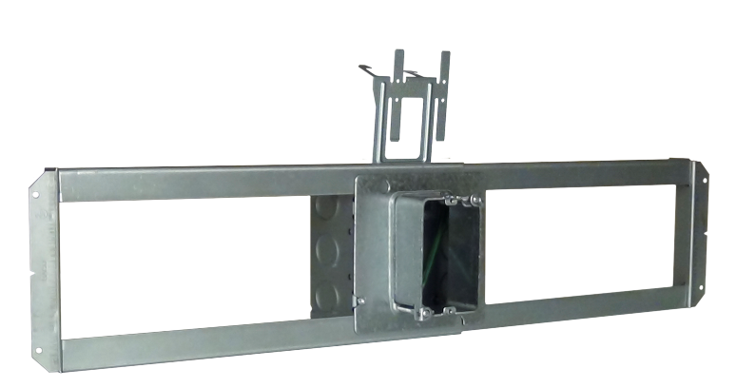
Prefabrication
Timing
Pre-Fab – 6 Weeks
New Product – 1 Year

Slide 14
Future Products

Slide 15
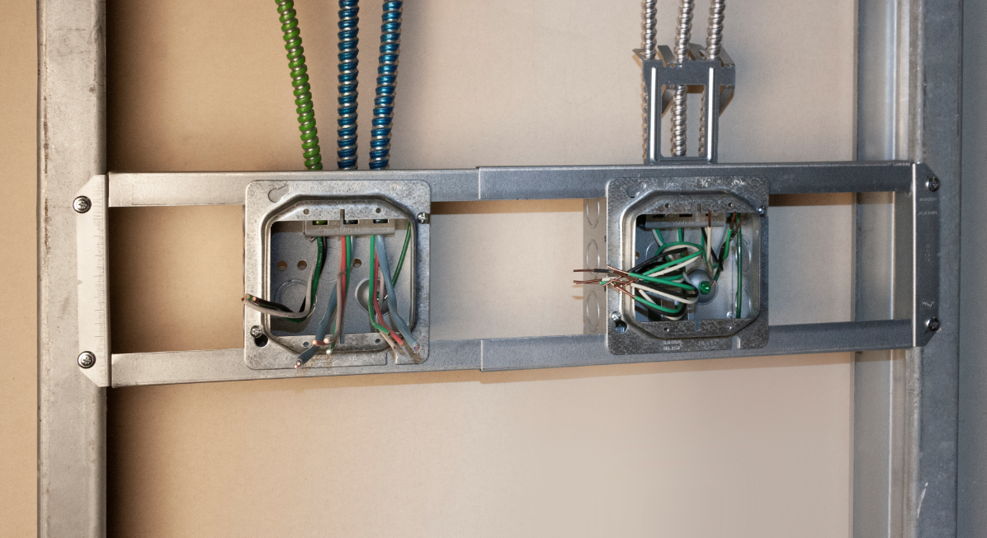
NPD Products
Driving the Future
VOC
4sq Stab-iT
4 11/16 Normal
Power
A/V

Slide 16
Good Luck!

